Slide 1

AWS Athena
By
Neerad Shakya
Developer, PACES Team
Notes:
11

Slide 2
Contents
Introduction
Amazon Athena
Use Cases
Date Formats
Pricings
Defining Data
Glue-Crawler
DDL Statements
Infrstructure as Code
Performance
Querying With Console and SqlWorkbench

Slide 3
1. INTRODUCTION

Slide 4
Amazon Athena
Serverless Interactive Query service.
Uses standard SQL to analyze data in S3.
Store data in S3
Define Tables
Query using SQL
No Infrastructure or Administration required
Notes:
The Output of one step is the Input for the Next step

Slide 5
Use Cases
Data Exploration and Discovery
Data Mining
Logs Analysis
Use SQL over stored data without RDS
Not appropriate for transactional use
Notes:
The Output of one step is the Input for the Next step

Slide 6
Data Formats
Text Files
CSV
TSV
Apache Web Logs
JSON
Simple
Nested
Compressed Files
Columnar Formats
Apache Parquet
Apache ORC
AVRO
Notes:
The Output of one step is the Input for the Next step

Slide 7

Pricing
Number of bytes scanned
Rounded to nearest MB
10MB minimum per query
$5/TB of Data Scanned
Notes:
The Output of one step is the Input for the Next step

Slide 8

Limitations
No update statements
No Stored Procedures
Limited query quota per account
Timeouts with too many partitions
(Make partition types as string so that Athena prunes partitions at metastore level)
Cross-region queries
Notes:
The Output of one step is the Input for the Next step

Slide 9
2. Defining Data

Slide 10
Glue Crawler
Serverless fully managed ETL (extract, transform, and load) service.
categorize your data, clean it, enrich it, and move it reliably between various data stores.
Discover data, transform it, and make it available for search and querying
Automatically infer database and table schema from your dataset, storing the associated metadata in the AWS Glue Data Catalog
Notes:
The Output of one step is the Input for the Next step

Slide 11
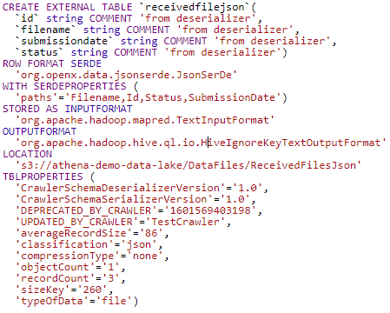
DDL Statements <>
Notes:
The Output of one step is the Input for the Next step

Slide 12
Infrastructure as Code <>
Use CDK of CF
Define your Database
Define your Tables
Define your Data
Define your Formats
Deploy
Notes:
The Output of one step is the Input for the Next step

Slide 13
3. Performance

Slide 14

Performance
Partition your data
s3://yourBucket/pathToTable/<PARTITION_COLUMN_NAME>=<VALUE>/<PARTITION_COLUMN_NAME>=<VALUE>/
Compression
Optimize file size
Columnar data store (Apache Parquet, Apache Orc)
Optimized queries (order by/limit by, join sequencing of tables, specify columns)
https://aws.amazon.com/blogs/big-data/top-10-performance-tuning-tips-for-amazon-athena/
Notes:
Partitioning divides your table into parts and keeps the related data together based on column values such as date, country, region, etc. Partitions act as virtual columns. You define them at table creation, and they can help reduce the amount of data scanned per query, thereby improving performance. You can restrict the amount of data scanned by a query by specifying filters based on the partition

Slide 15
4. Querying With Console and SqlWorkbench

Slide 16
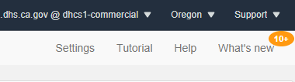
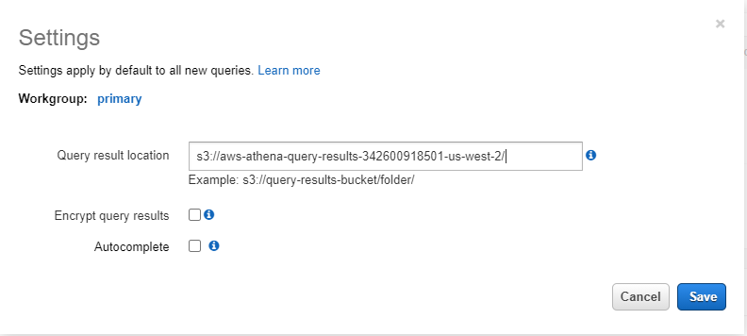
Make sure you are able to run Query!
Notes:
Paths

Slide 17

5. Question and Answer

Slide 18
References
https://docs.aws.amazon.com/athena/latest/ug/athena-ug.pdf
https://medium.com/swlh/tutorial-build-your-data-lake-using-aws-s3-athena-150c1aaa44cf
https://docs.aws.amazon.com/glue/
https://docs.aws.amazon.com/athena/latest/ug/glue-athena.html
https://docs.aws.amazon.com/athena/latest/ug/other-notable-limitations.html
https://aws.amazon.com/blogs/big-data/top-10-performance-tuning-tips-for-amazon-athena/
https://prestodb.io/docs/current/functions/aggregate.html

